Slide 1

-Omics Data Integration with O2PLS
Parasitology, McGill University
Supervisor: Prof. Jianguo (Jeff) Xia
March 21st, 2019
Jin Kweon, PhD Candidate

Slide 2
Outline
Describe the lab
What I have worked on
Background of –Omics and data integration of -Omics
Motivation of –Omics integration
O2PLS & OnPLS
–Omics integration applications with O2PLS (*Demo)

Slide 3
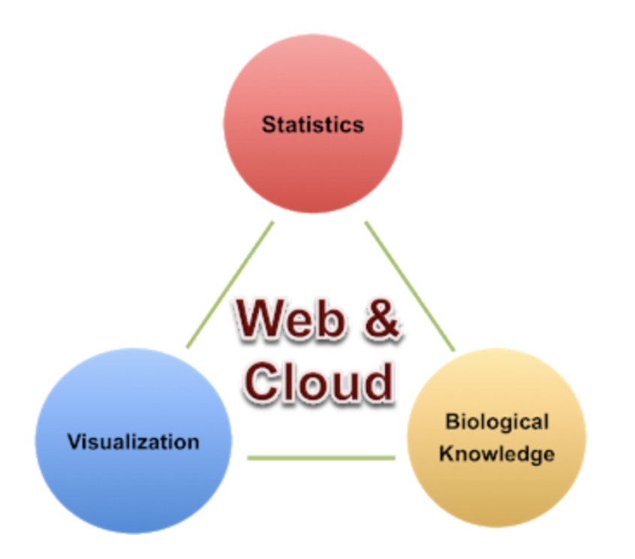
Jeff Xia’s Lab
Parasitology, Macdonald Campus
Bioinformatics and Statistical Informatics
Most Popular Languages: R, Java, and Python
Journal Club Meeting : Every other Friday
Group Meeting: Every Friday 9:30am
Mostly Dry Lab
Interests: Metabolomics and Software development
Xia

Slide 4
Lists of Works
1. Try different multivariate statistics methods of mixOmics and OnPLS, to learn how to integrate multi-omics data.
2. To learn, and possibly to extend, and benchmark mixOmics and OmicsPLS for multi-omics integration.
3. Assess the quality of O2PLS and OnPLS. (with different datasets)
4. Collect 20~30 applicable –omics datasets
4. Develop and summarize useful outputs of O2PLS
5. Develop user-interactive website. (*currently working on it)
Notes:
1. mixOmics website
2. OmicsPLS -> O2PLS R package for O2PLS
4. Collecting good datasets can be really useful as I m trying to make the lists of the example datasets for the website; this is pretty harder than I thought
5&6. I am mostly working on developing already-existed tools and make it more user-friendly & public!!! (red highlights)
By the way, O2PLS = Two way orthogonal Partial Least Square

Slide 5
-Omics?
Bouhaddani S.e., et al. (2016).
Notes:
High dimensional data plays an important role in medical statistics.
And, we could measure more and more variables faster and easier with better technologies.
For example, we could have huge number of variables reaching to millions in life sciences.
Here this diagram represents basic level of biology complexity of omics: genomics, transcriptomics, proteomics, and metabolomics.
“It is assumed that these omics follow the hierarchy as shown, where metabolomics has the most direct influence on the phenotype. The Genomics and Transcriptomicss data are typically the ones having a high dimensional flavor.”
“The first block is the genome, it contains all genetic information. The expressed genes in the form of RNA are grouped in the transcriptomics. In between are the proteins, which is the basis for metabolites. In general the metabolites are seen as a product of the chain consisting of the genome, transcriptome and proteome. The last block in the chain is the phenotype, the observable personal health characteristics.”
With measurements on the omics variables, researchers are generally looking for similar patterns between different omics. Some of the questions are looking for the relationships and patterns of how variables from one data sets with the variables from the other data sets, and all these intellectual curiosities comes into questions: how we could analyze omics together, to get more useful information and help understanding and predict the functions of genes and associations with metabolites and phenotypes.
And, O2PLS is one of the methods to analyze omics together.

Slide 6
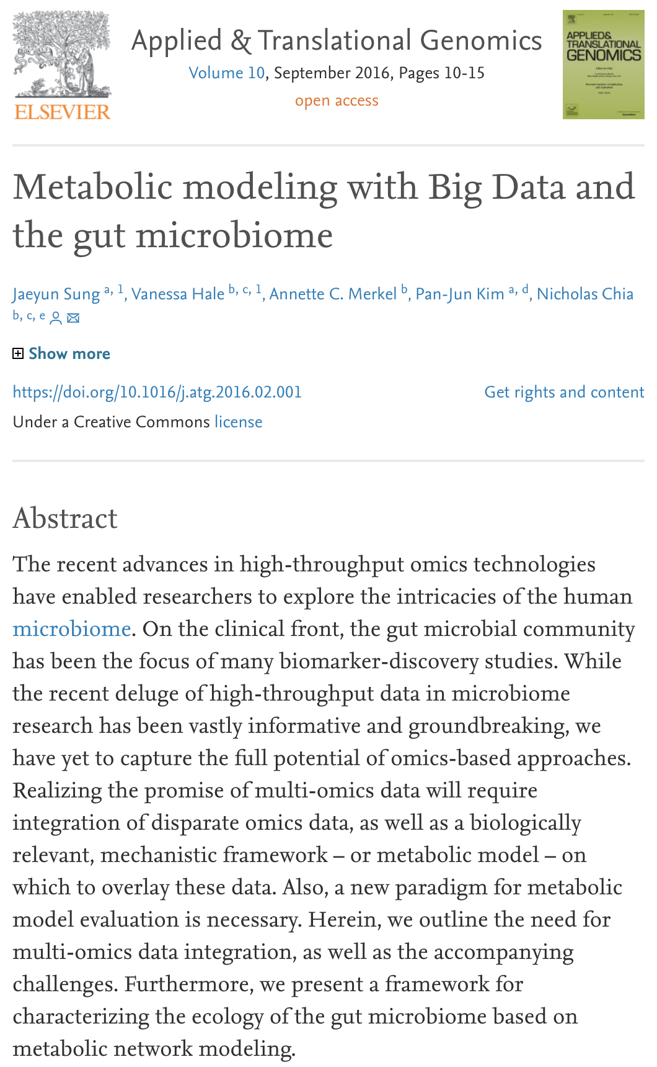
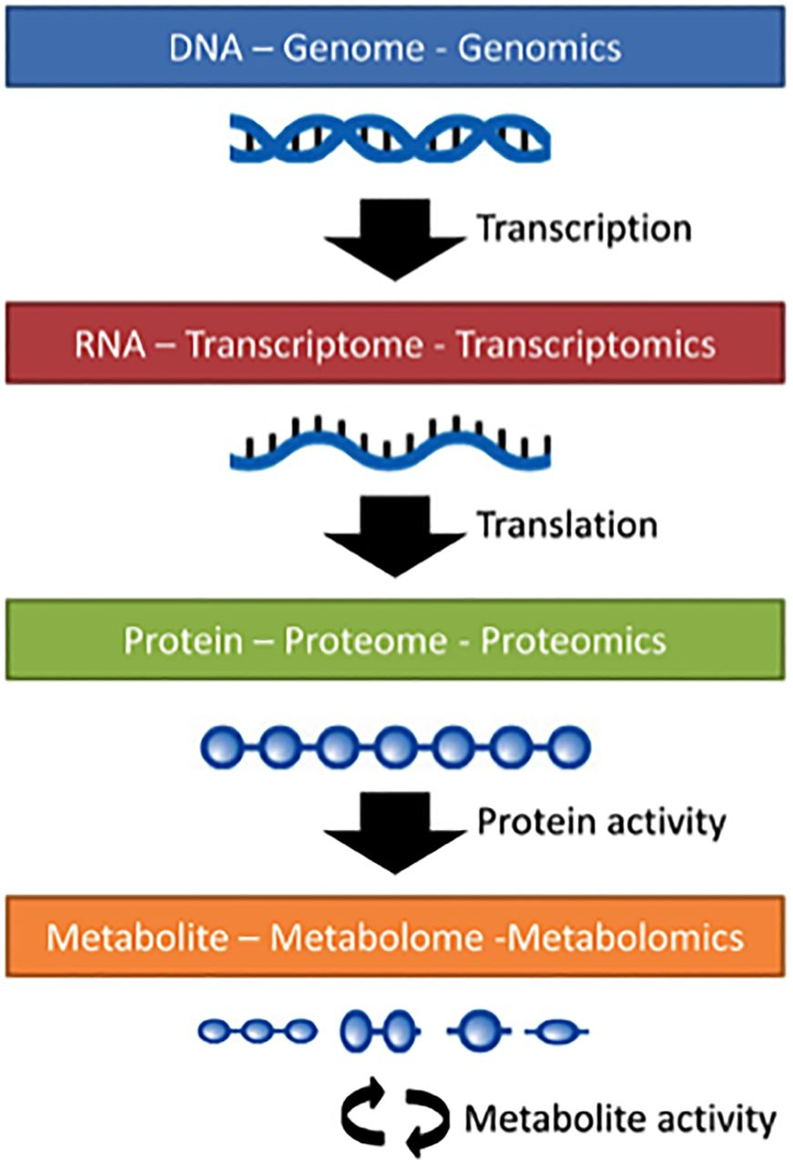
Background
Zhou, G. (2019).
Sung J, et al. (2016).
Notes:
So, as I mentioned in the previous slide, many recent technologies enable us to large amounts of –Omics data. (Technology advances have enabled researchers to quantify molecules at different molecular levels.)
Here again, the paper also highlighted how important it is to understand many omics datasets into one, not separately.
“Realizing the promise of multi-omics data will require integration of disparate omics data, as well as a biologically relevant, mechanistic framework – or metabolic model – on which to overlay these data.”
------------------------------------------------------------------------------------------------------------------------------------------------------------------------------------
We have large amounts of data – but the variables are NOT independent each other, meaning that constructing networks would help understand them. (and the more correlations as the data gets bigger!)
Later, the paper also mentioned “to fully understand the global picture of how organisms modulate the biochemical environment within our gut, especially in health and disease conditions, it is essential to obtain a clear evaluation of the complex interactions characterizing microbial ecology.”
Multi-omics approach integrates data from single omics levels and generate a global view.

Slide 7
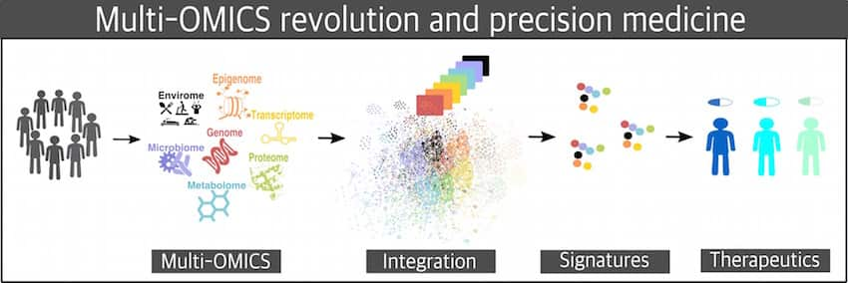
Motivation of multi-omics
Complement missing or unreliable information from single analysis
Increased confidence as multiple sources point to same evidence
Systems-level understanding by considering the whole omics cascade
Precision medicine → Comprehensive omics profile of individuals.
Zhou, G. (2019).
Notes:
More concretely, analysis of multi-omics data generated for a single study would be able to complement missing or unreliable information from the analysis of single omics.
Secondly, it will simply increase confidence as multiple data points towards same evidence. At the same time, it will reduce the amount of false positives.
Finally, as biological processes often involves more than one type of molecules, a multi-omics approach will enable a better systems-level understanding.
------------------------------------------------------------------------------------------------------------------------------------------------
* (cited) However, the small number of samples compared to the large number of predictors limits statistical power and accuracy of current methods, which may lead to non-reproducible molecular signatures. Finally, while the same samples are profiled within a single study, the different omics platforms employed have their own inherent platform-specific artifacts such as variation between manufacturers and omics technologies. Data heterogeneity is therefore a major obstacle to combining multiple omics studies

Slide 8
Two Approaches
1) Biological networks/Model driven (Bio-networks)
- Based on our prior knowledge usually in the form of networks
- Easy to understand but cannot be used if we don’t have the knowledge
2) Multivariate statistics/Data driven (O2PLS & OnPLS)
Purely statistical, generally applicable but hard to understand
Based on statistical associations and correlations of data across omics layers
Notes:
So Our lab is currently working on two approaches for multi-omics integrations.
*Why hard to understandn for data driven? ➔ one reason is because we reduce the dimension. Second reason can be we integrate them together.

Slide 9
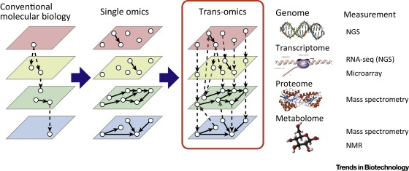
First Model – Metabolic Network
It provides a big picture of how metabolites and biochemical reactions are interconnected within a particular organism!
The power of the approach is a) summarize the mechanistic chemical flor through an entire organism and b) it has potential to integrate multiple data types
Sung J, et al. (2016).
Notes:
One approach to tackle multi-omics integration is through network integration.
As the biomolecules of different omics are shown to interact with each other, it is possible to build a global molecular interaction network by connecting them.
This can be done based on prior knowledge.
It consists of mapping the experimental data to existing interactions found in databases.

Slide 10
Problem: 1. Not all cultured microbes have fully-assembled genomes. 2. Not all fully-assembled genomes are completely annotated. 3. Need to identify entities to include in the model. 4. Integrate myriad databases. 5. Statistically assess the networks. 6. Need to have prior knowledge of each model.
Sung J, et al. (2016).
Notes:
<Picture shown>
Yeah… This is way more complicated…. (beyond my level… haha)

Slide 11
Second Model – Multivariate Statistics
Good performance on both low (small number of variables) and high dimensions.
Results were in agreement with previous findings.
Able to identify other associative genes and metabolites, while taking into account systematic variation in the data. (inaccurate observations that can affect the results that are not in statistical control)
Interpret Orthogonal variation.
Notes:
O2PLS stands for Two-way Orthogonal Partial Least Squares, and OnPLS is an extension of O2PLS.
For third point:
For the fourth point:
as we decompose datasets with joint and orthogonal (or, globally joint, locally joint, unique for OnPLS), it helps interpretation!
------------------------------------------------------------------------------------------------------------
* (cited) Nowadays, system biologists, computational biologists and bioinformaticians dealing with multi-omics studies face the challenge of ‘missing’ the biological question, thus relying on data-driven statistical approaches in the absence of specific hypotheses to be tested.

Slide 12
Why not just PLS?
PLS:
Multivariate regression
Finds the fundamental relations between two matrices (X and Y)
A PLS model will try to find the multidimensional direction in the X space that explains the maximum multidimensional variance direction in the Y space. (maximize covariance of X and Y)
PLS regression is particularly suited when the matrix of predictors has more variables than observations, and when there is multicollinearity among X values.
PLS: biased due to systematic variations
OPLS: corrects systematic variations
O2PLS: symmetric approach of OPLS
Notes:
PLS seemingly perfect; however, as many other statistics approaches there are some problems when it comes to apply on biology problems.
PLS estimates are biased due to systematic variations are present…
Asymmetric Orthogonal PLS (OPLS) corrects systematic variation in the design matrix before presenting data to PLS, and this OPLS gives easier interpretation of the model as estimates focus more on predictive variation in the design matrix
But, we need symmetric approach of OPLS (correct for orthogonal variations in both data X and Y) to integrate data sets. For integrating two, it is O2PLS, which models both predictive and systematic variation.

Slide 13
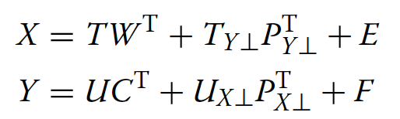
O2PLS
Which variables are related to those in another dataset? Ans: Joint part
Which variables are not related, but still important? Ans: Orthogonal part
Which variables are relevant, providing more insight in the network? Ans: Noise part
Notes:
O2PLS decomposes the variation into three parts.
Joint part (representation of the integration of the two data sets)
Orthogonal part (independent from those from joint part, and unique systematic variation in the dataset X that does not contribute to the prediction of the dataset Y)
Noise part (capture unsystematic variation = measurement error + individual difference)
First term is the best approximation based on cov with the other dataset Y, where P does not contain the direction of orthogonal variation.
Second is explaining orthogonal variation in X.
Third is explaining the noise.
T & U –related are scores (projection of X and Y to the low dimension) and W & C & P –related are loadings (importance of X and Y to the low dimensions)

Slide 14
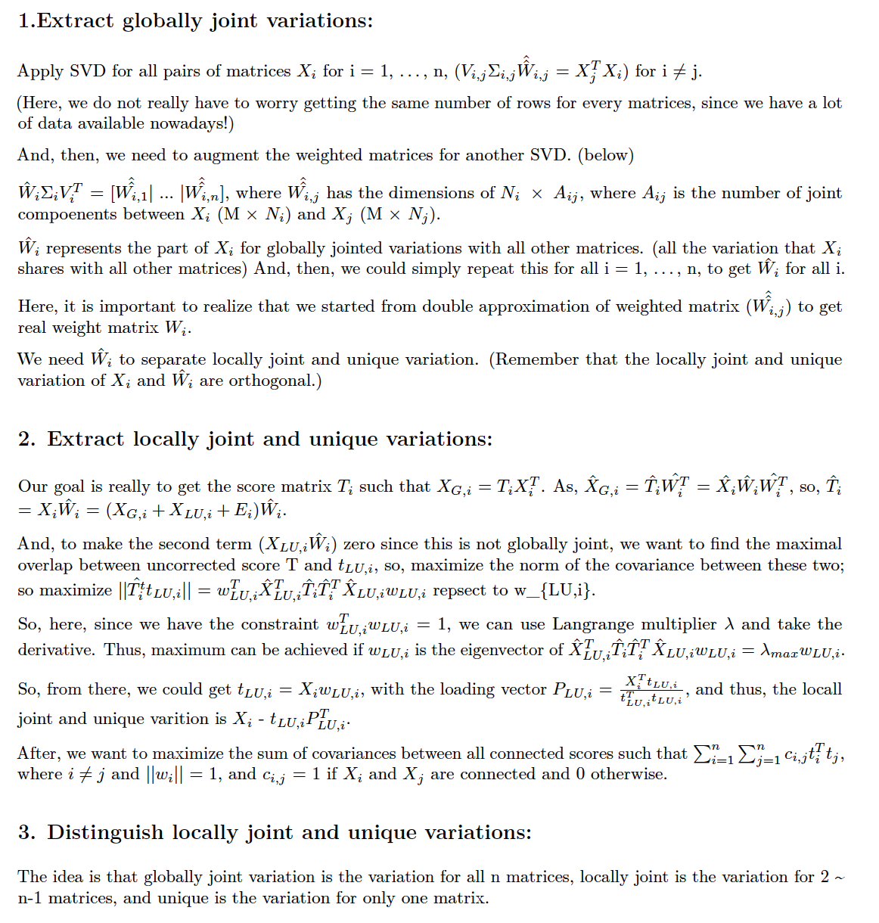
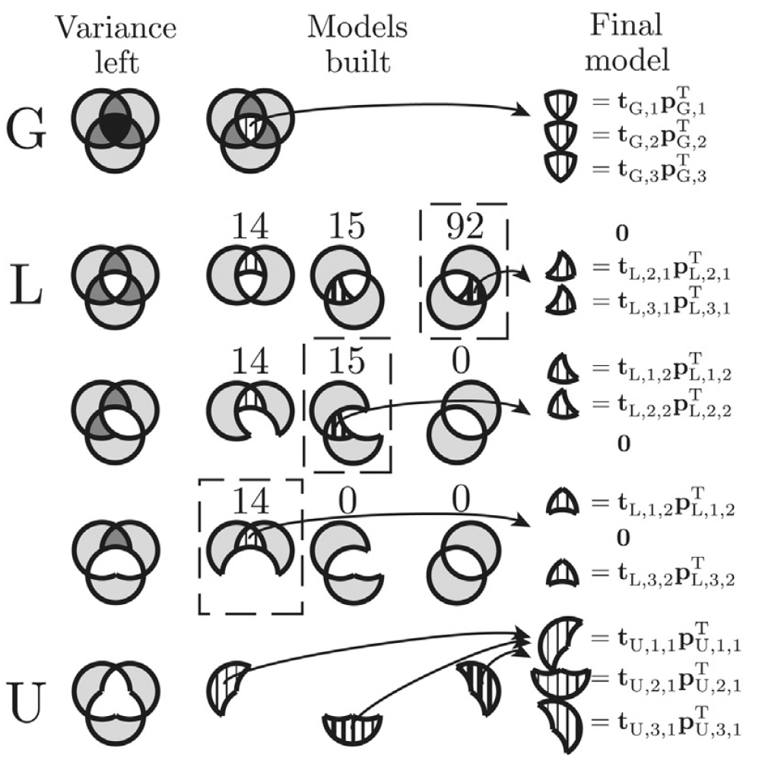
Steps (OnPLS) for Full-approach
Bouhaddani S.e., et al. (2016).
Löfstedt T., et al. (2013).
Notes:
Extract Globally joint variations
Extract locally joint and unique variations
Distinguish locally joint and unique variations

Slide 15
Data Preprocessing
1. Check row numbers and names are the same
2. Missing value checks and imputations
-Remove variables with > xx% missing values
-Exclude variables with missing values
-Replace by a small value
-Replace by column mean/median/mean
-Estimate by KNN/PPCA/BPCA/SVD
3. Filtering
-Low count filter
-Low variance filter
4. Normalization
-Mean-center
-Auto-scaling
-Two parameter Box-cox
-Generalized log transformation
Notes:
Estimation: k-nearest neighbour (KNN), probabilistic PCA (PPCA), Bayesian PCA (BPCA) method, Singular Value Decomposition (SVD)
*there are more techniques we are planning to implement on the website – but those are the main stuff!!!

Slide 16
O2PLS
-Decide number of joint & orthogonal variables
-Variation tables
-SSQ plots
-Loading plots and tables
-Joint score and Quality of predictions checking of the least squares regression
-Score plots and tables
-Correlation plots for variables from original data and scores
-PCA on O2PLS scores
-Correlation visualizations
-Sankey diagram
Notes:
*There are more tables diagrams or any other visualizations I have implemennted, but I want to talk about parts of them (not all) that we think important to the users.

Slide 17
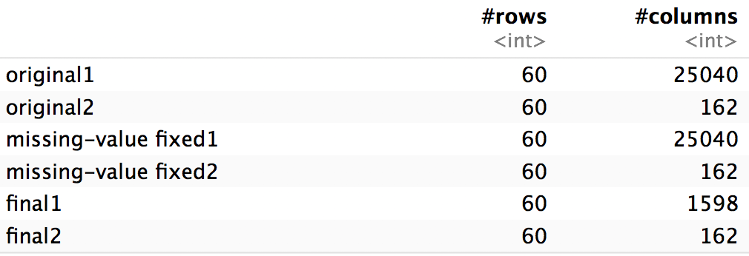
Data Background
-Originally retrieved from NCI 60 (Genomics, metabolomics, transcriptomics, proteomics, etc.)
-Two datasets: protein (proteomics) and mRNA expression (transcriptomics)
-Tissue types: breast, central nervous system, colon, leukemia, melanoma, lung, ovarian, prostate, and renal
Notes:
*First of all, I just want to say that I am not going into too much details of biological interpretation of the analysis of O2PLS; however, I just want to go over the tables, summaries, and diagrams and other outputs that I implemented that the users are going to see on the website we are currently making.
NCI 60:
No missing rows, so no need to remove rows for any reasons, but there were around 7000 missing values in messenger RNA and no missing value at all in proteins.
Filtered on mRNA only -> intersection of top 20% of absolute maximum of gene expression levels of each gene and top 20% of IQR of each gene.

Slide 18
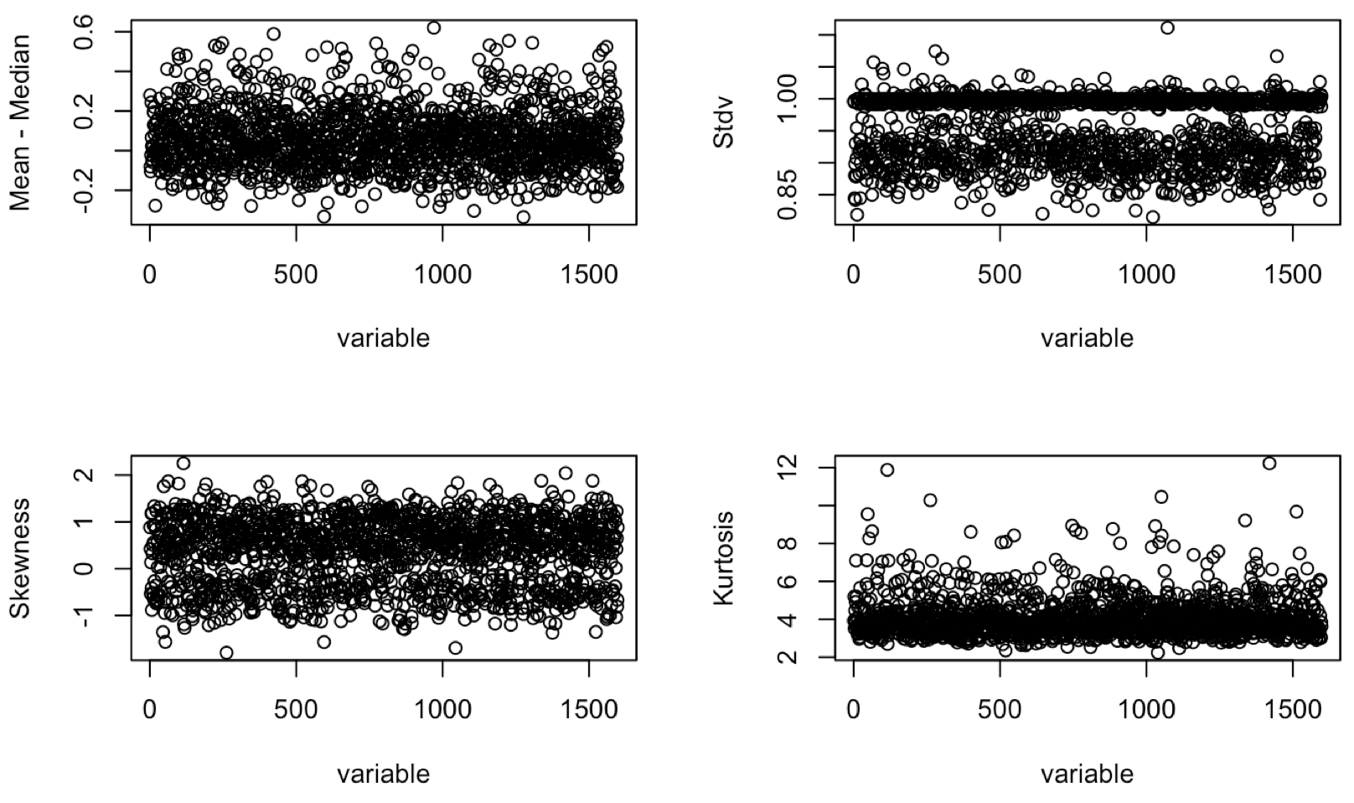
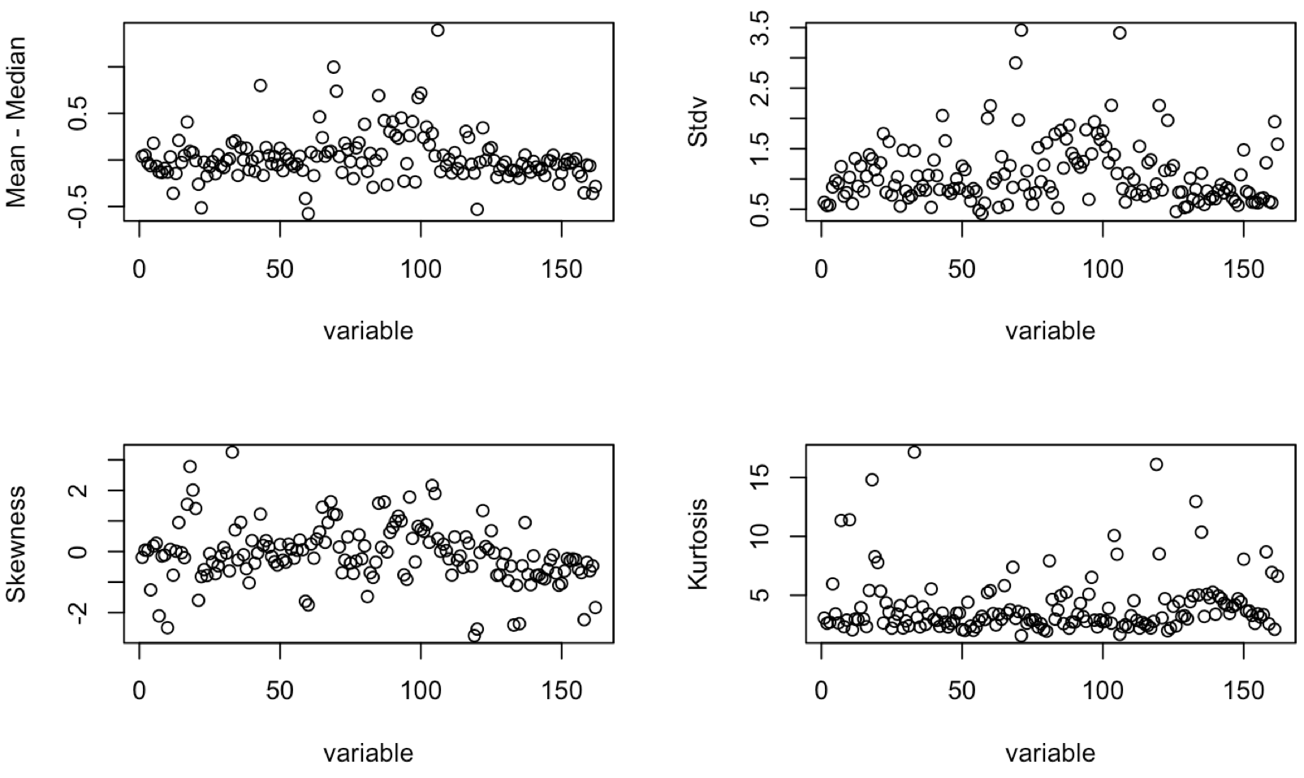
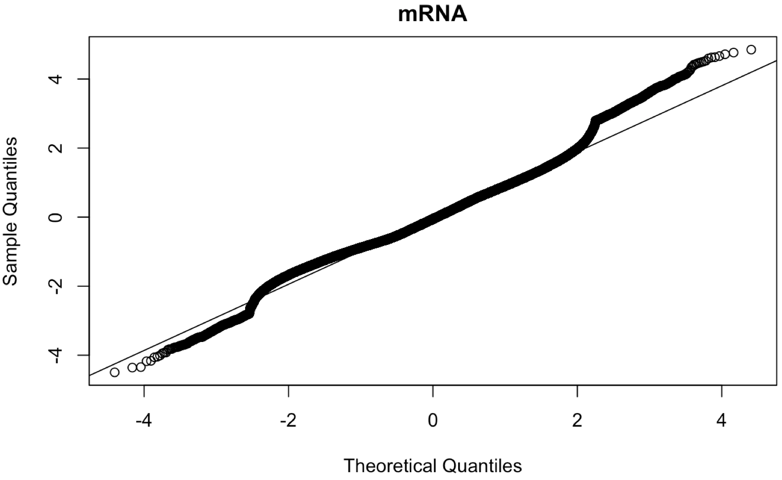
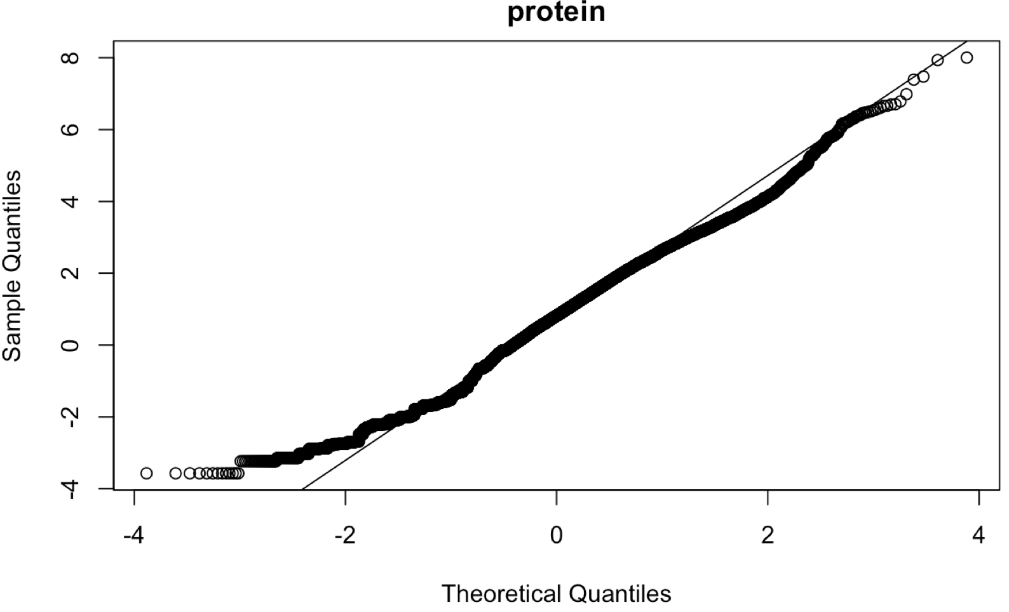
Data normalization
Notes:
For each dataset, showing qqplot, Mean - Median, standard deviation, skewness, and kurtosis are good way to measure normality of the datasets.
O2PLS is better performed using the normalized data, we are making inference on loadings.
*Give interpretation of graphs (left: mRNA, right: protein):
Both mRNA and proteins are normal – range of the standard deviations are quite acceptable with no big outliers, with the difference of mean and median is subtle. Furthermore, skewness and kurtosis are pretty low.

Slide 19
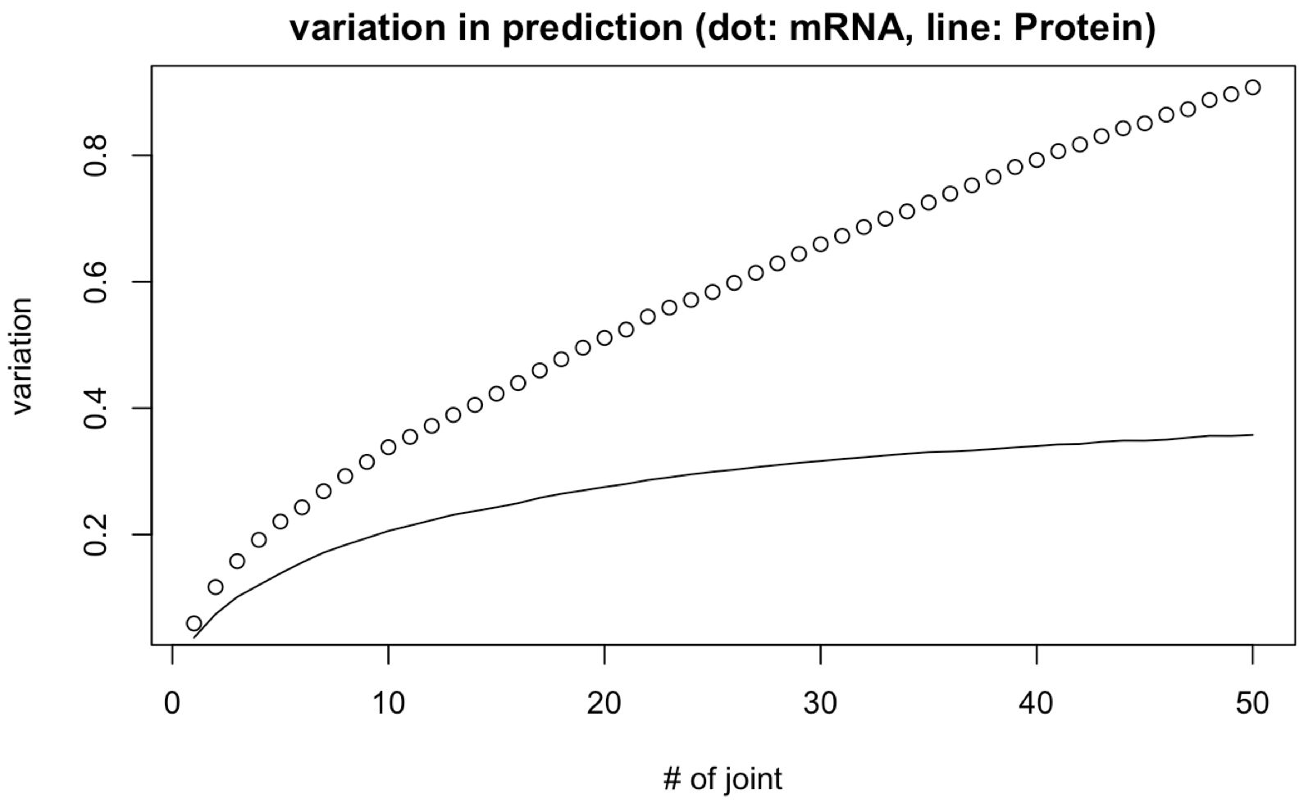
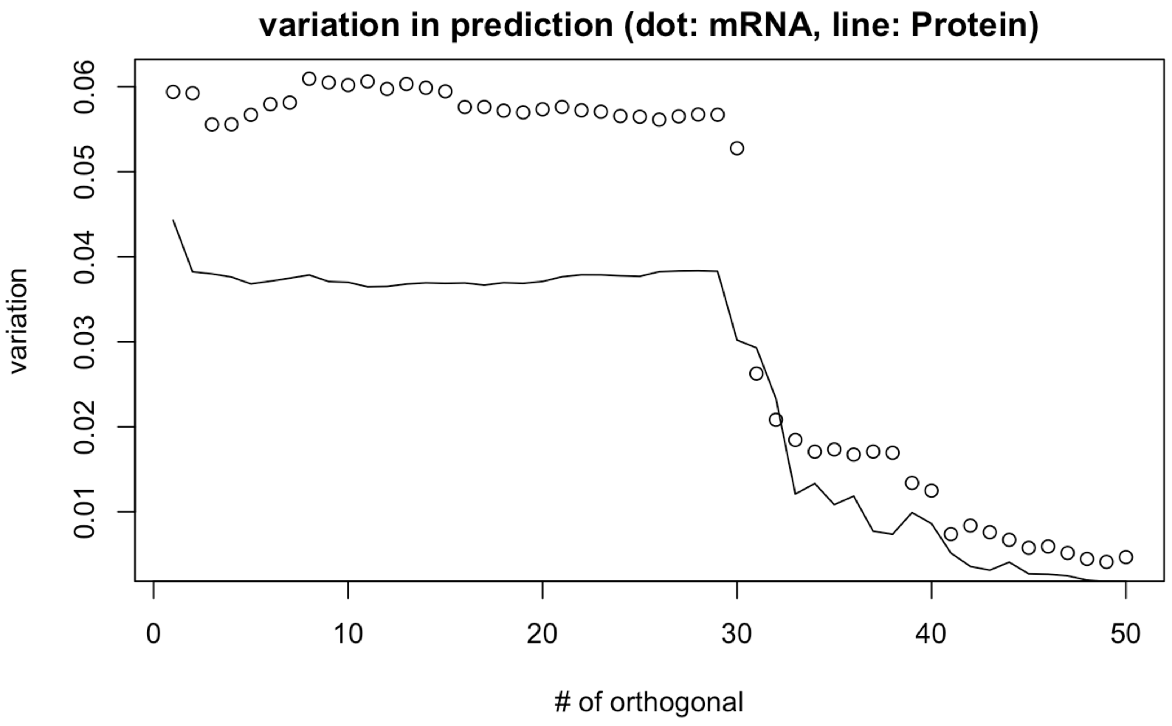
O2PLS – criteria of choosing # of variables
Fixed orthogonal
Fixed joint
Notes:
One of the important steps every user should spend some time on is making the right decision to pick the right number of variables for joint and orthogonal.
There are three different ways to choose the number of variables for O2PLS.
The first two are either fixing number of orthogonal variables or number of joint variables.
The advantage of this method is since we fix the number of orthogonal variables beforehand, computationally it is faster as we do not perform cross validations.
Having 50 iterations is just random... 50 is pretty good enough. (Y axis represents the variation of the predicted mRNA or protein – in other words, it makes sense to see if we have more number of joint variables, we can find better relationships between these two datasets. But, really, increasing the number of variables will prevent us making good understandings and its also computationally bad)
This method tells us how many variables we need to capture enough variability of both data.
If we increase the number of orthogonal too much, it will interrupt capturing the variability of the data.

Slide 20
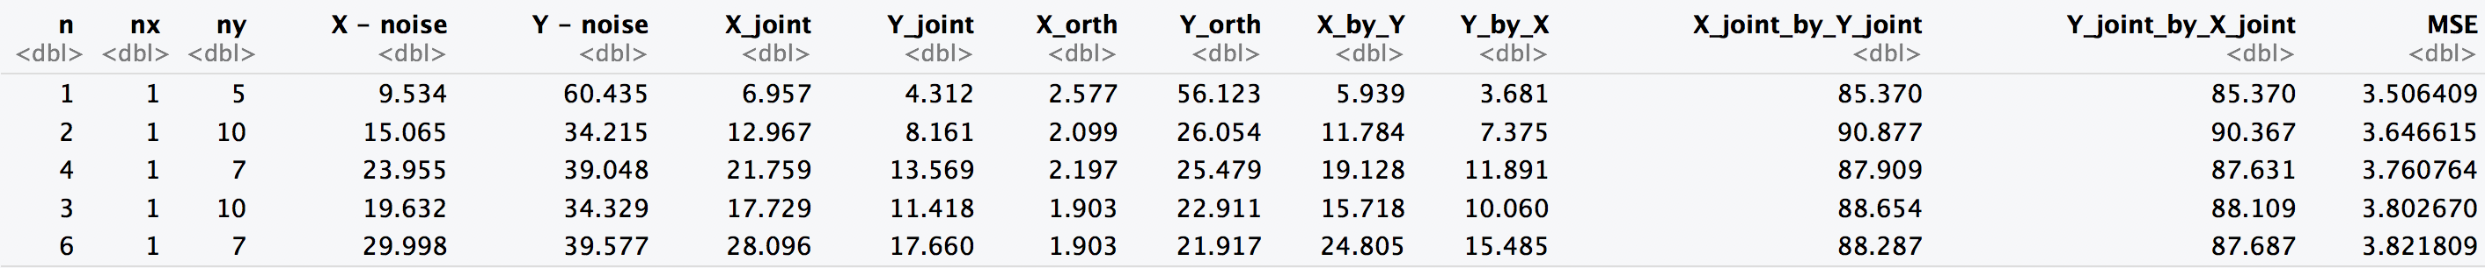
O2PLS – criterion of choosing # of variables
Variation Table 1 - MSE with CV or Joint predictions (unit: %)
1. prediction error or 2. adj R^2 (way faster)
n: # of joint
nx: # of orthogonal x
X – noise: joint + orthogonal variations of X
X_joint: joint variation of X (maximum variation can be explained by Y)
X_orth: orthogonal variation of X
X_by_Y: X that can be explained by Y (always smaller than X_joint)
X_joint_by_Y_joint: joint X that can be explained by Y (always bigger than X_by_Y)
Notes:
This last option is what I like the most personally but its computationally the worst/slowest…
*Explain how the 1. prediction error 2. adj R^2 are different !!!!
We do the 10-folds cross-validations and get the MSE, and list out the combinations with small MSE.
Since there is no strict rule, I personally list out top 5 or 10 combinations of list of number of variables with the smallest MSE, and then compare the prediction power (X joint by Y joint or vice versa) and decide from there…
*Smallest MSE does not guarantee the best predictive power, so it is important for users to decide what option to go for…
This variance table is also useful to know how the variance is decomposed and how the two omics datasets are related.
For the further analysis, I will go for the last option (n = 6, nx = 1, ny = 7) as they are giving not huge MSE but gives a lot of predictability in joint!!!

Slide 21
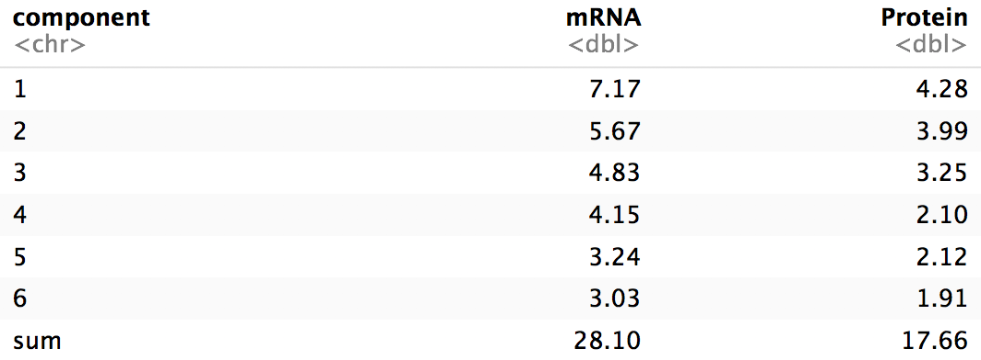
O2PLS – Variation table 2
Absolute and Relative Summary
O2PLS Joint Summary (unit: %)
Notes:
It is another variation table to show the both absolute and relative variance.
Some people like to see how the absolute sum of squares.
Another table at the bottom shows how each component share the joint structures for both mRNA and protein.
How does these tables help you?:

Slide 22
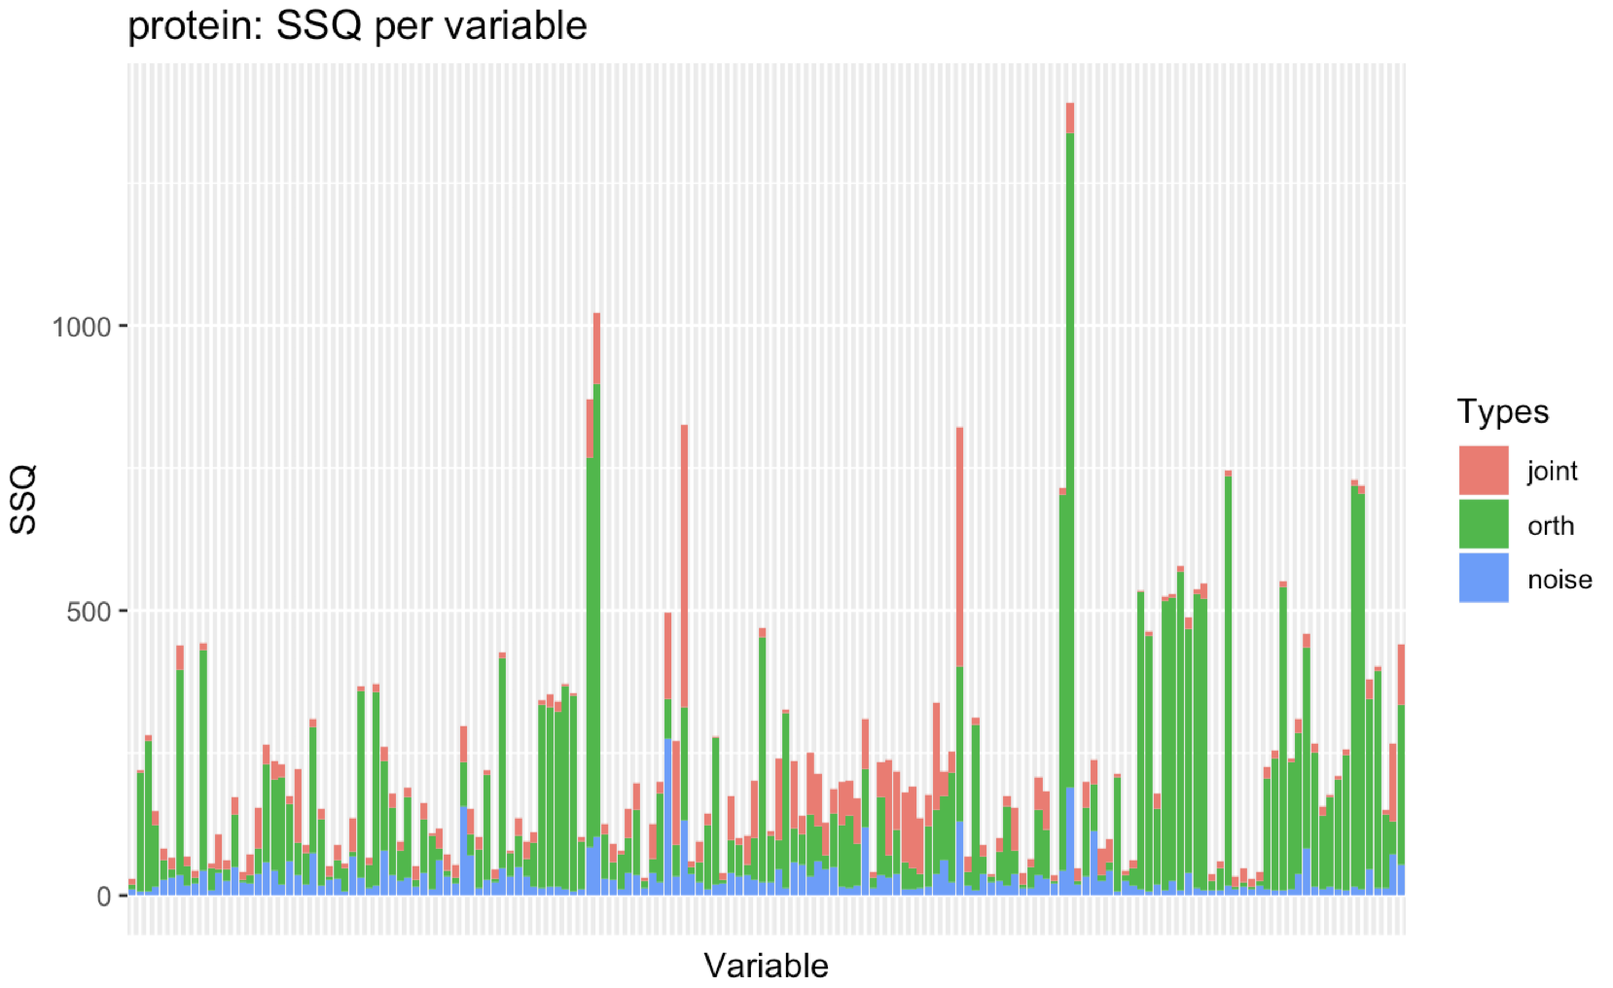
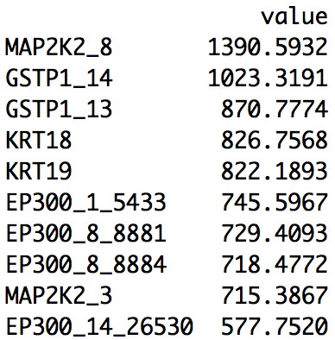
O2PLS – SSQ plots (protein)
Top 10 values table
Notes:
This is the variation plots.
SSQ for each variable can gives me some insights how each variable is important for different types of variations (joint, ortho, and noise).
So, for example, we can visually grap the idea that there are more systematic and noise variations in our protein data when it comes to integratiging with the mRNA in NCI 60.
With the diagrams of these with variation tables can actually help us a lot to understand our O2PLS outputs.
Plots with the top 10 values tables! (and people can change how many values they want to show)
*I sometimes include only protein plots, as there are way more variables in mRNA and just looks so complicated in the presentation

Slide 23
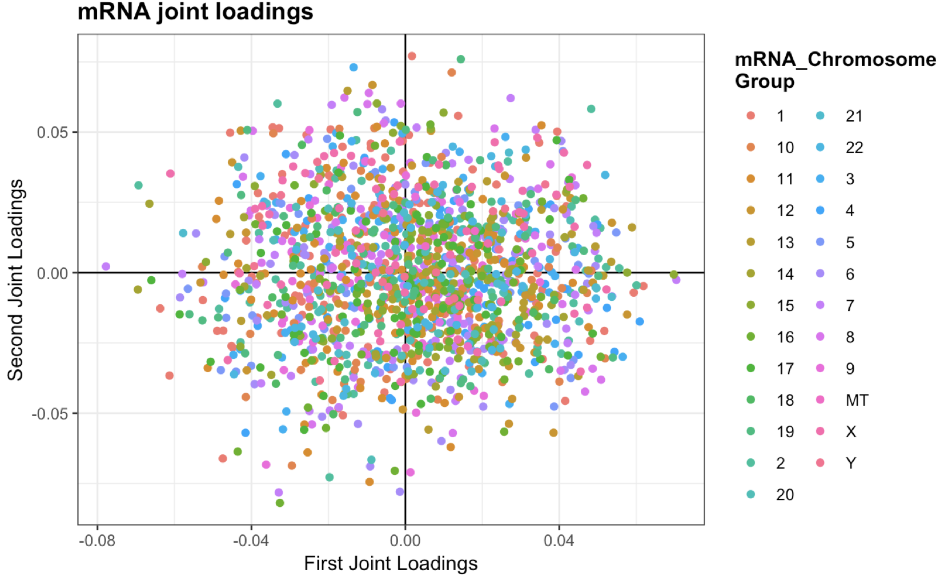
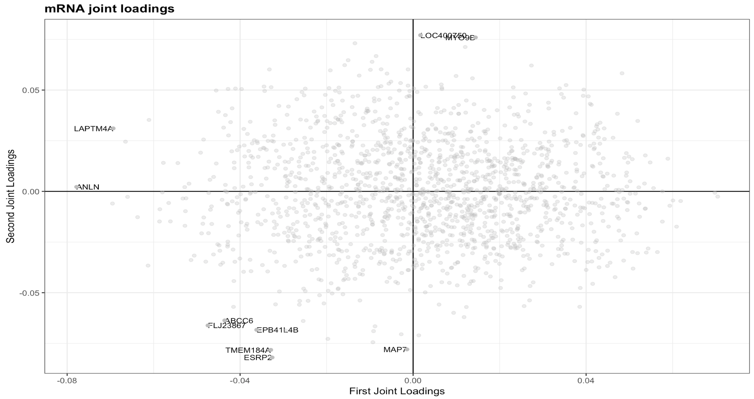
O2PLS – Joint loading v.s. Joint loading
Notes:
Indicate relative importance of each variable to corresponding component in messenger RNA.
In the picture left, I colored them based on chromosomes. For these datasets, it is just hard to see what chromosome groups attribute the most on each loading, but if <show the right handside pic> I uncolor them and shows the messenger RNA with the top 10 highest absolute values of euclidean distance from the origin, we can get better ideas.

Slide 24
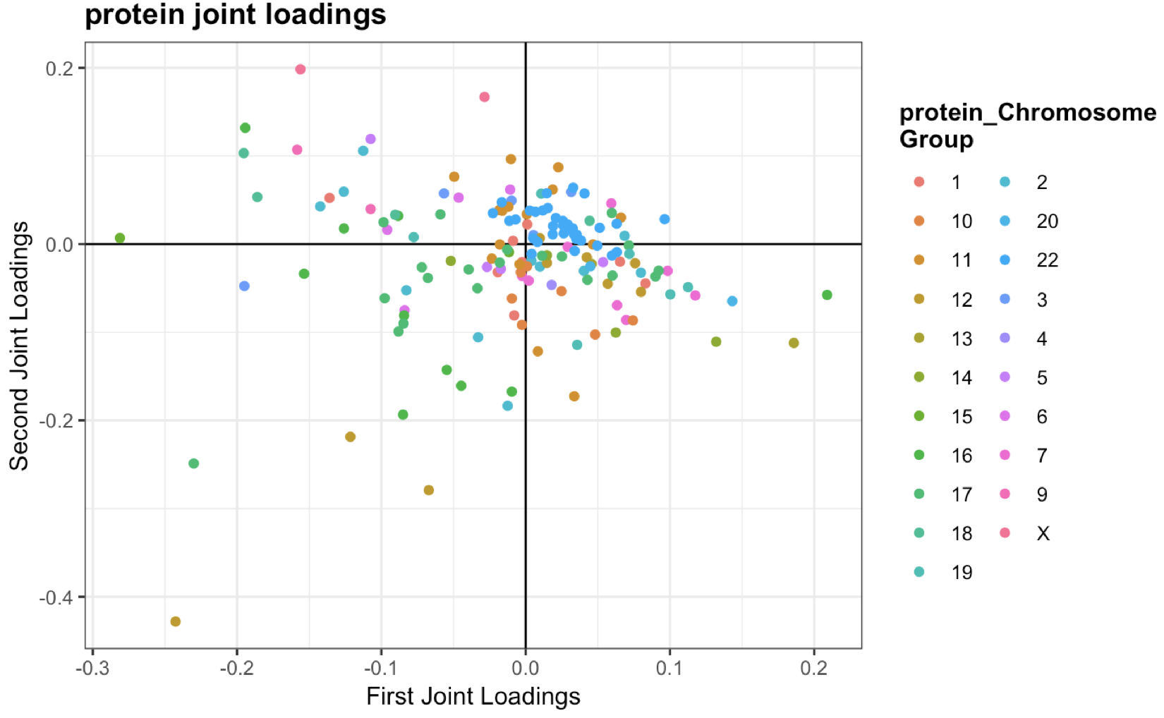
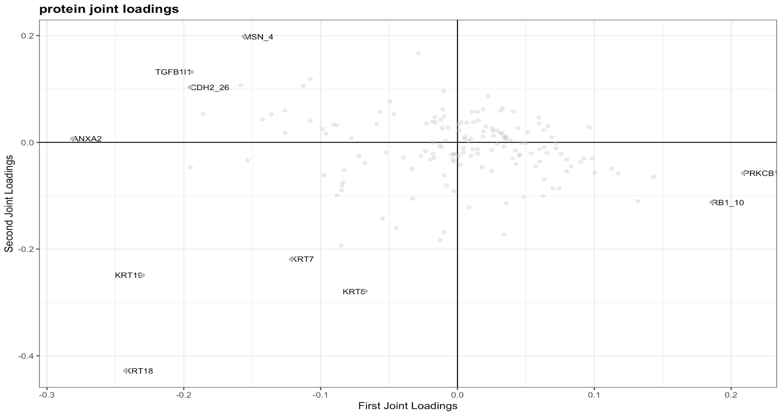
O2PLS – Joint loading v.s. Joint loading
Notes:
Indicate relative importance of each variable to corresponding component for protein, with groups of chromosomes.

Slide 25
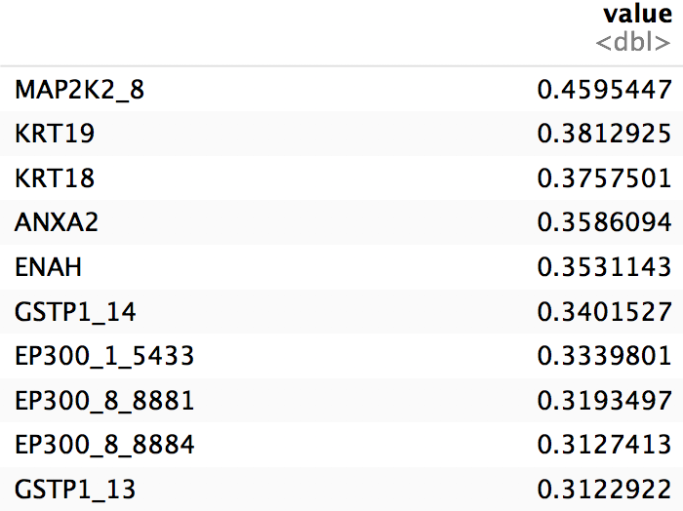
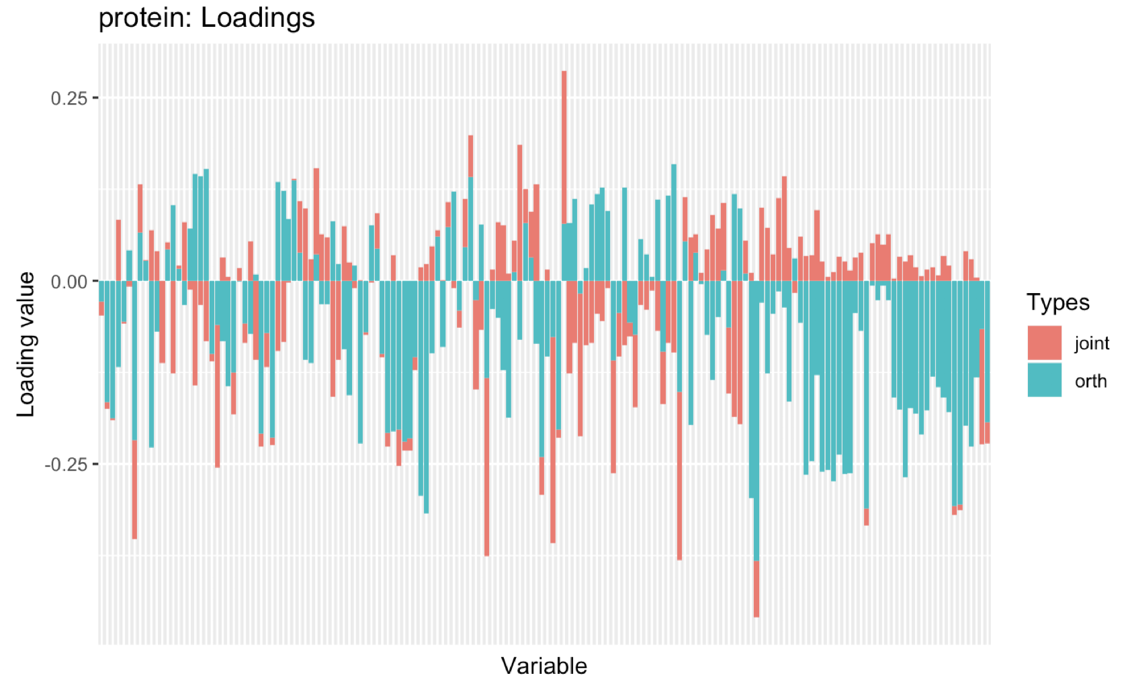
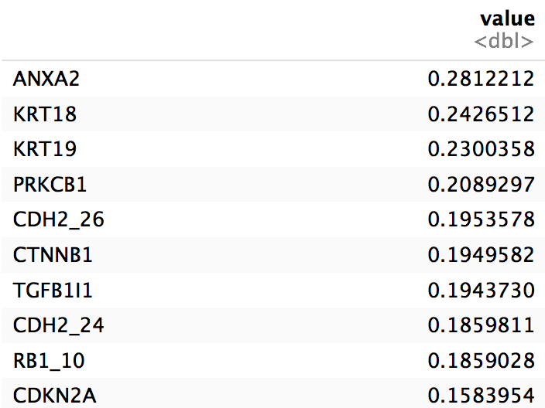
O2PLS – Joint loading plots
Sum of absolute joint and orth
Sum of absolute joint
Notes:
We can see how different heights each variable gets.
Remember the loadings stand for the importance to each variable to the corresponding subspace/score.
And, we show tables for both sum of absolute values of joint and orthogonal and sum of absolute joint variables.
"A high contribution to the SSQ does not guarantee high contribution to the loadings, as variance is not equal to covariance.”
<Show picture> It might be helpful how the signs are different in joint and orthogonal loadings, since these variables are associated with the score in opposite directions.

Slide 26
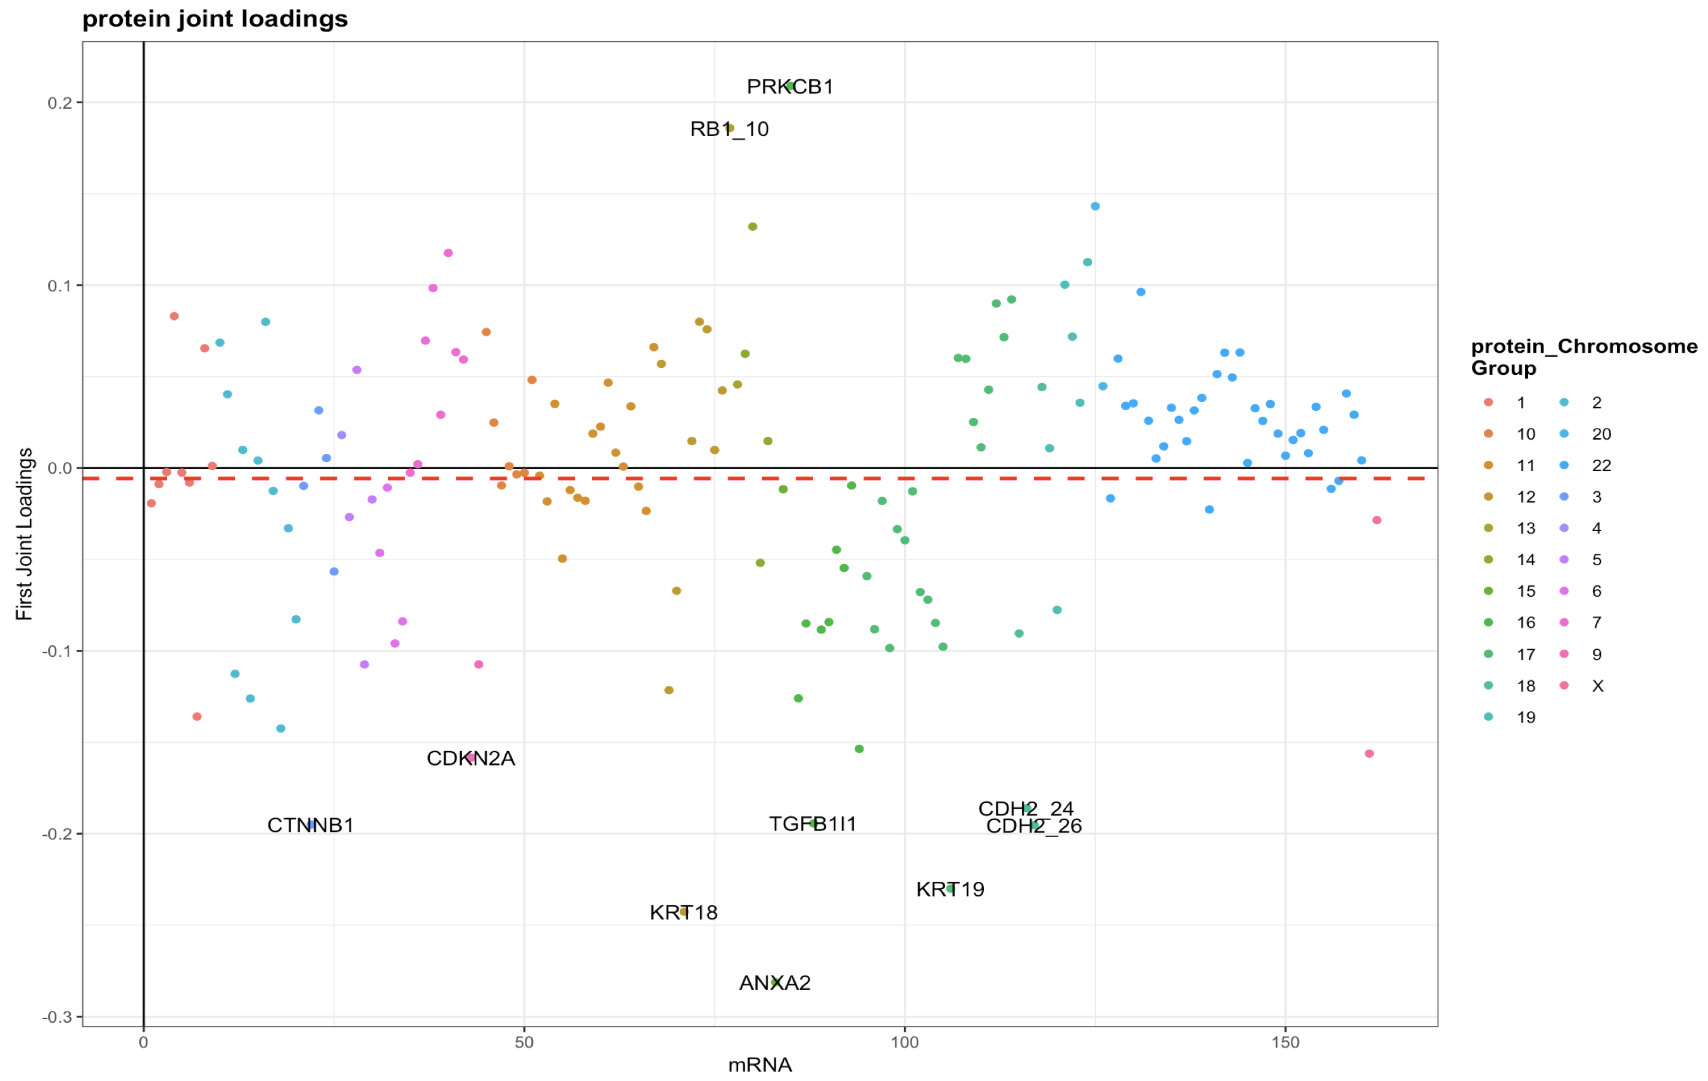
O2PLS – Joint loadings (protein)
Notes:
Another plots of loading values with the texts of the smallest and biggest absolute values…. (this is loading v.s. variables)
Loading values help us find the subgroups. (i.e. seems like chromosome 15, 16, 17 have the most significant variables)
At least we can feel what variables are non-significant and significant, and if we know the groups and clusters, we might be able to get ideas which cluster/group is having high/low loadings. Last but not least, outlier can be spotted as well.
Users need to understand what each score represents. (Loading visualization can help users clarify them)
The O2PLS algorithm itself would not give you an answer, and as like what PCA does, it is the users' responsibilities to interpret what each score represents. And, it is possible for people have different conclusions at the end based on their backgrounds.

Slide 27
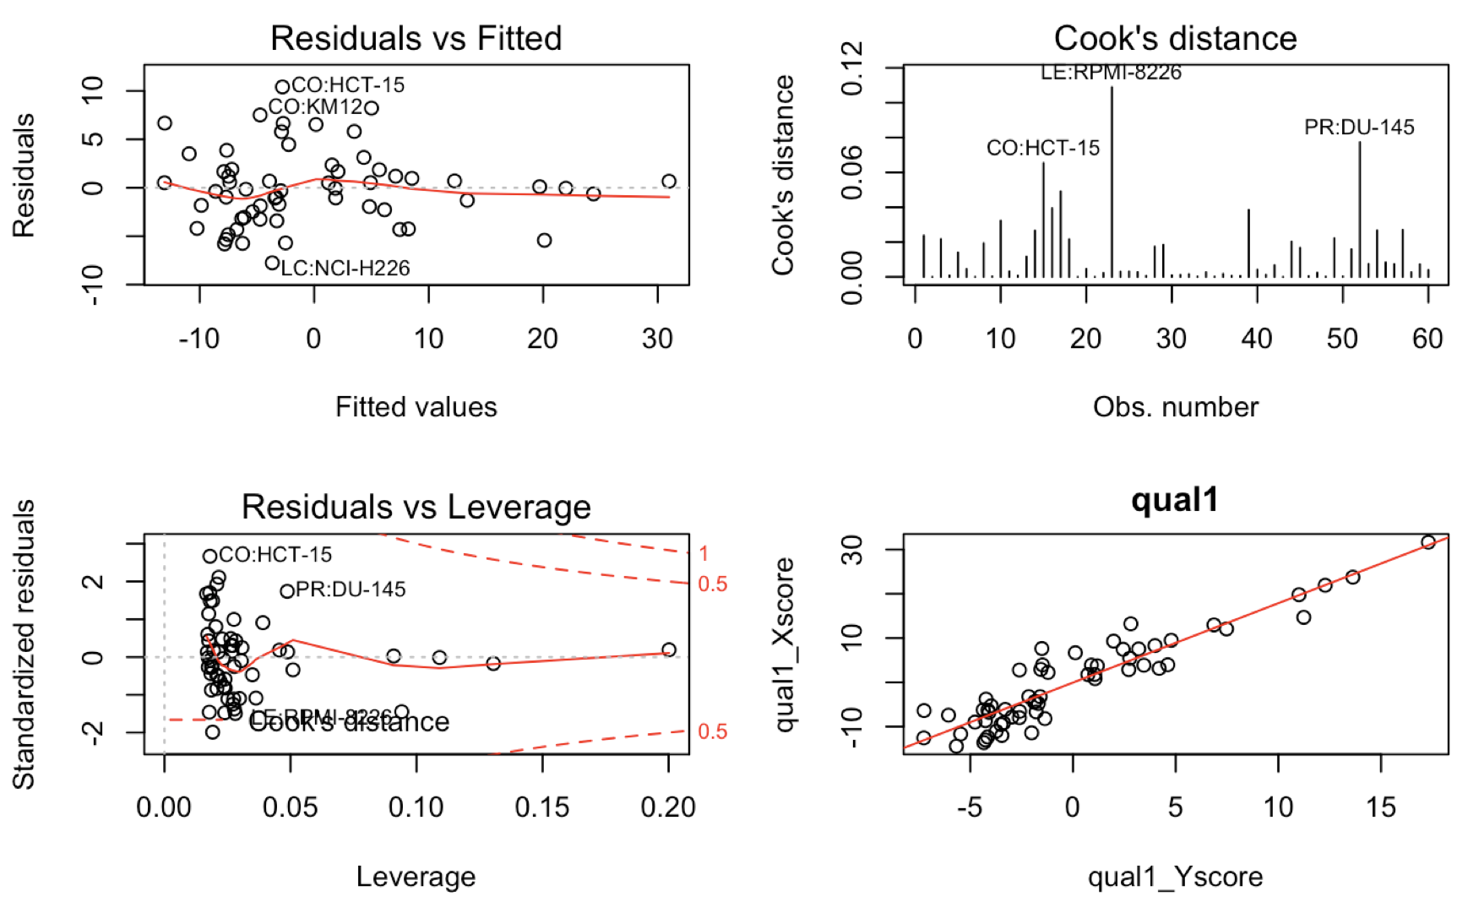
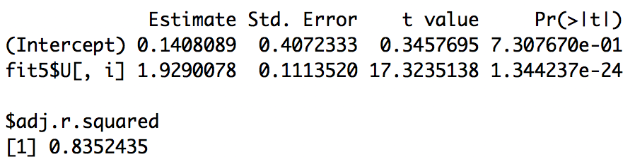
O2PLS – Least square (Quality of predictions)
Notes:
One good thing about O2PLS function is it provides the least square linear model of T and U. (i.e. U = TB_T + H, where B_T is a square matrix of representing regression coefficents for two models and H is a noise)
To see how perfect the prediction between each score, I plotted
residual v.s. fitted
cook’s distance
std residual v.s. leverage
linear plot
and all the p-values and adjusted r-square, and coefficients.

Slide 28
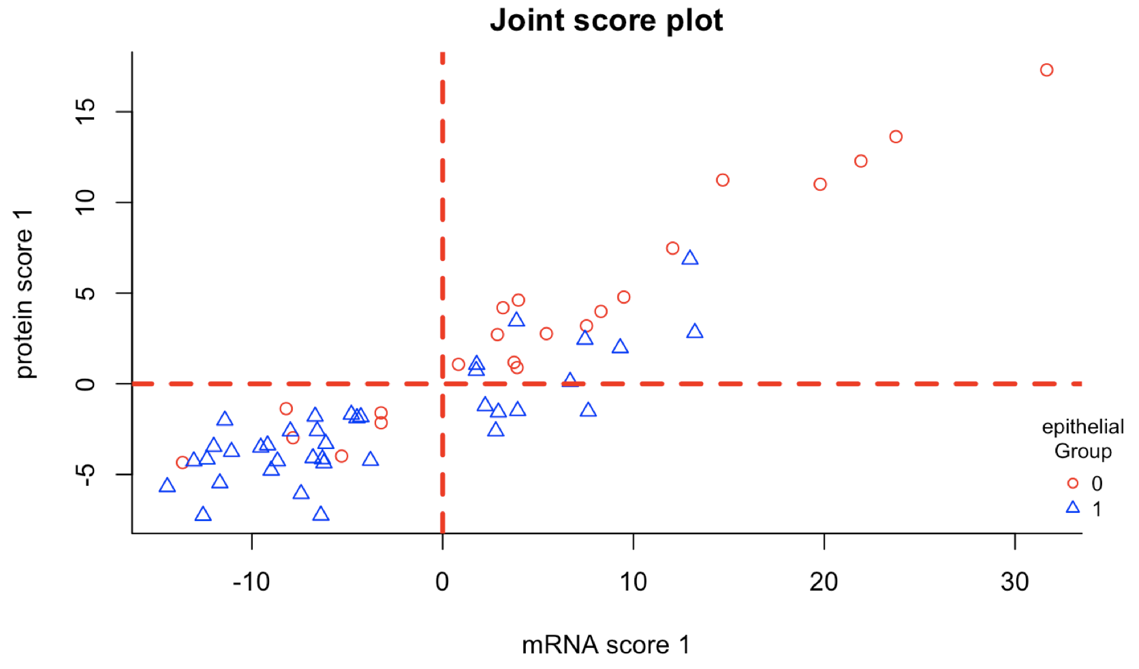
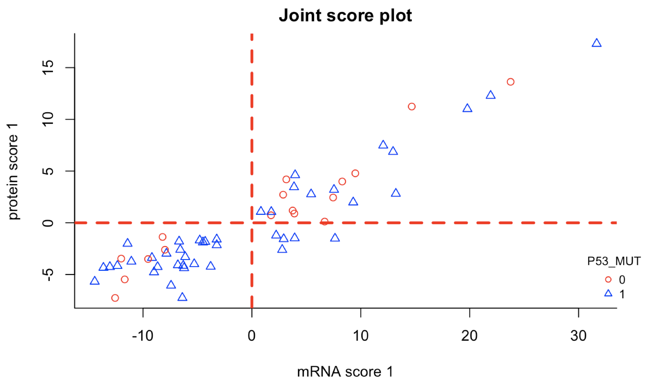
O2PLS – Joint score plots
Notes:
So, as the two joint scores have linear relationship, we could have another plots based on information of sample factors.
This is different with PCA pc/score plots… WE are getting two scores from two different datasets. (so, PCA used to be 1D, then this can be considered as 2D)
*Two plots based on different factors/groups
(*TP 53 mutation is …)
(*epithelial is …)

Slide 29
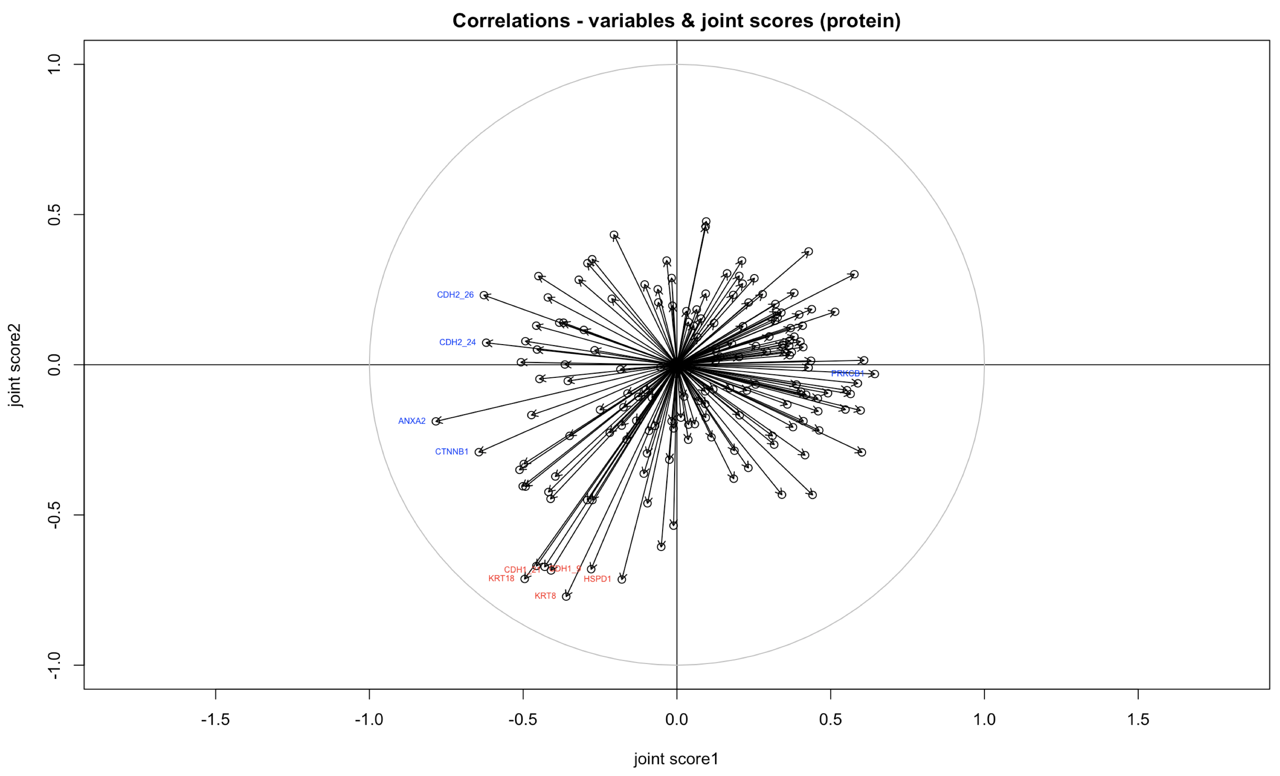
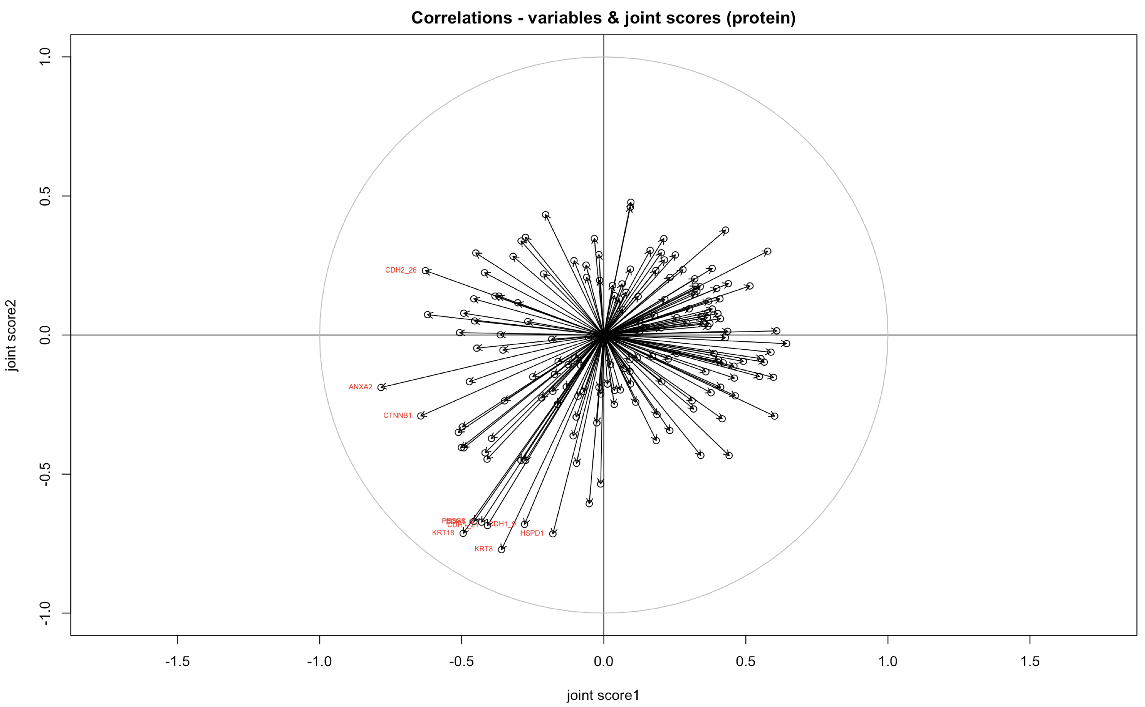
O2PLS – Correlation of variables and scores
Notes:
Correlation with original protein variables (60 by 162) with scores (60 by 6). This can be interpreted in the same way as PCA correlation circle
The radius of the circles is 1, meaning that as the maximum length of arrows are all 1, and the closer to the circle, it means it shows some correlations better. Also, the direction of the arrows gives some interpretations.
getting the five absolute values of high pc1 and five absolute values of high pc2
getting the 10 high length

Slide 30
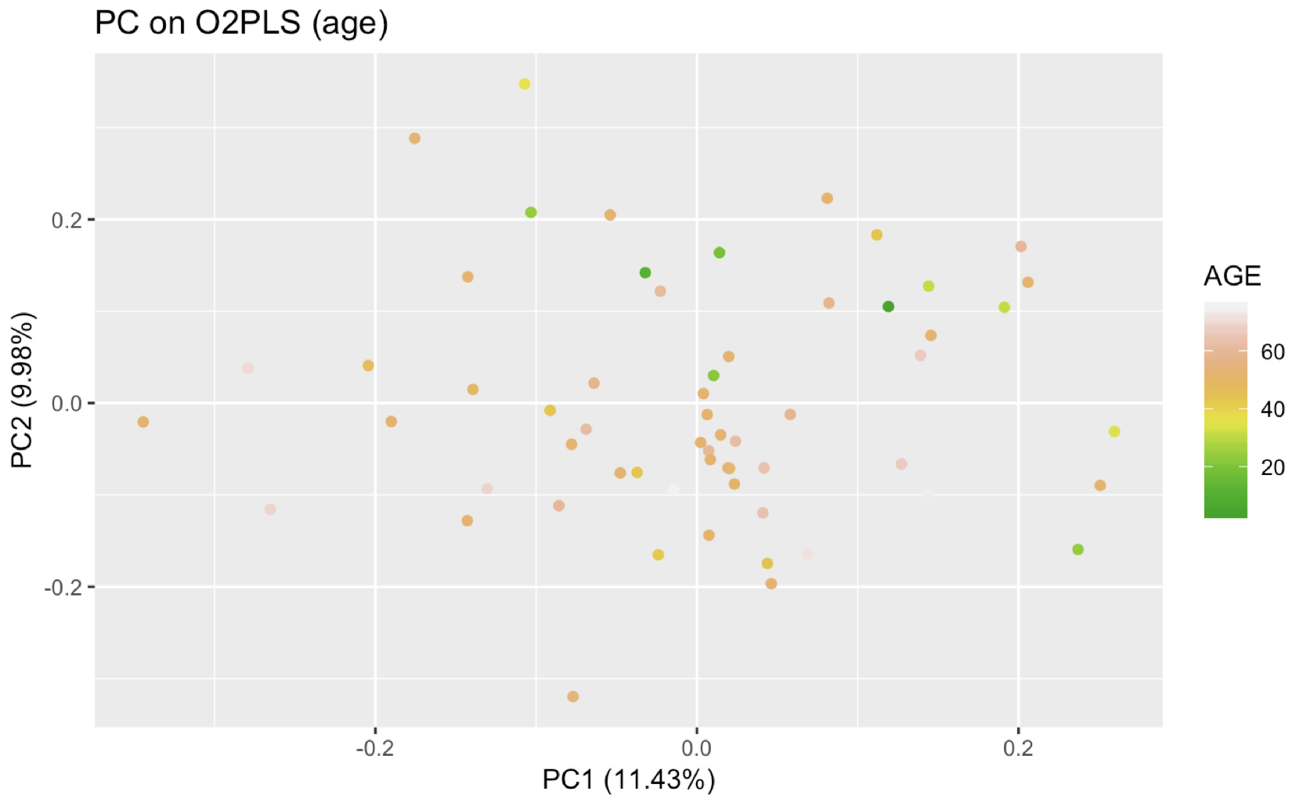
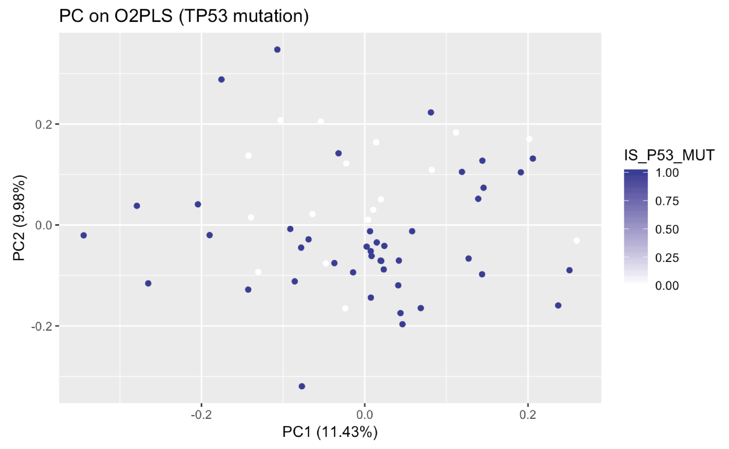
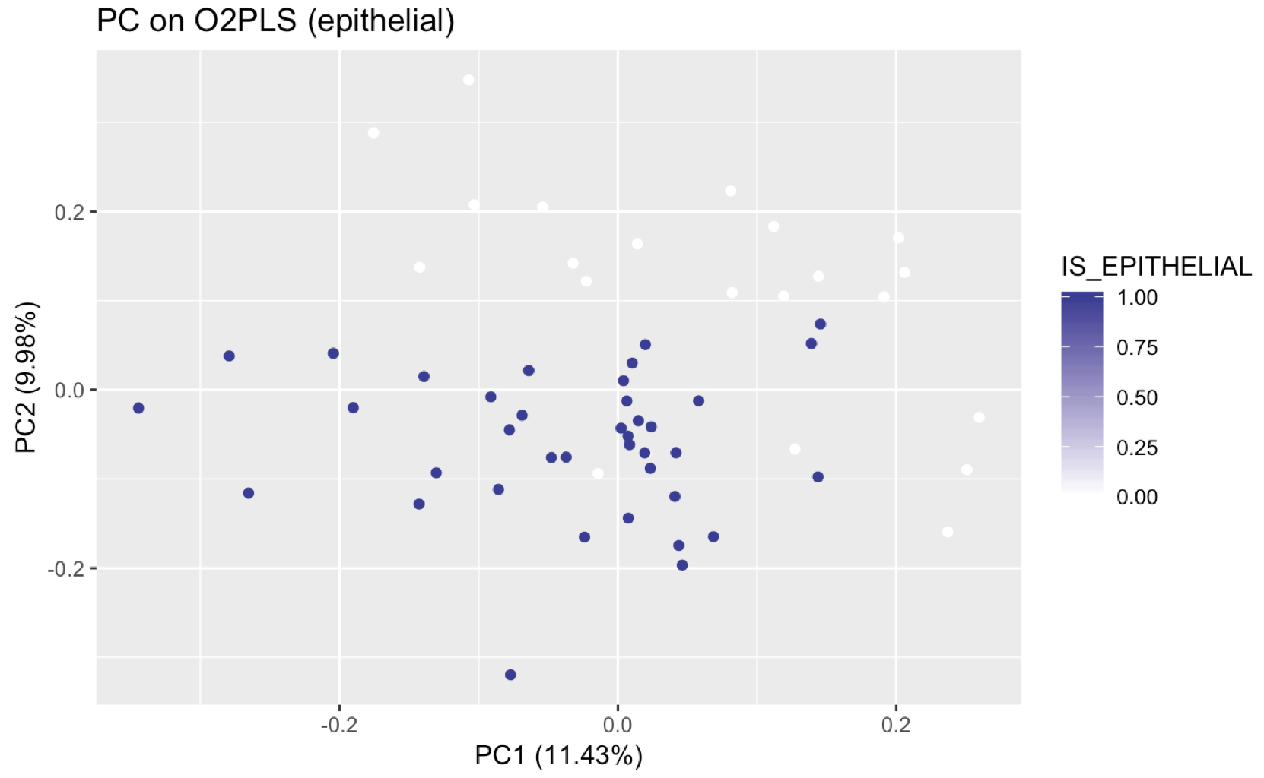
O2PLS – PCA on O2PLS scores
Notes:
The another beautiful thing about O2PLS is we can apply PCA or other dimension reduction methods to understand the entire O2PLS models without losing much interpretation.
The first score plot on age
The second score plot on TP53 mutation
The third score plot on epithelial

Slide 31
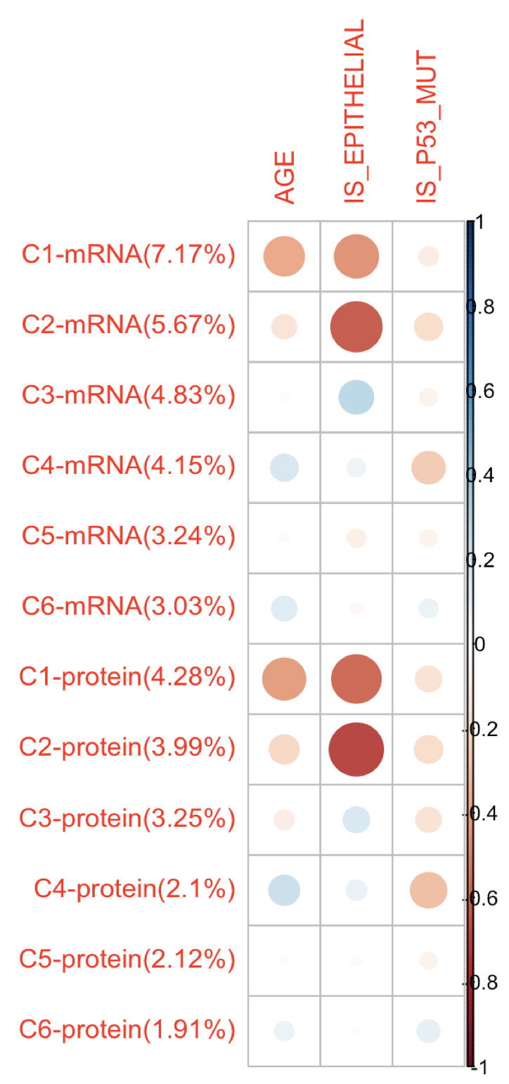
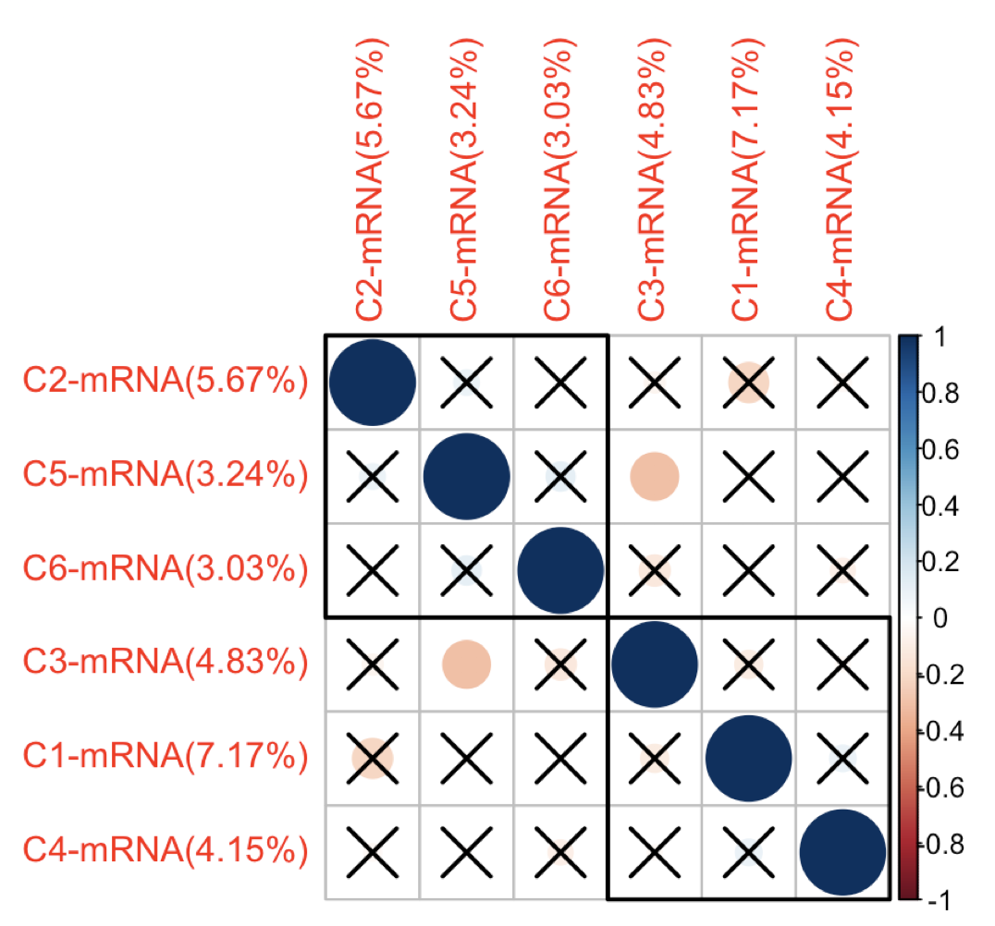
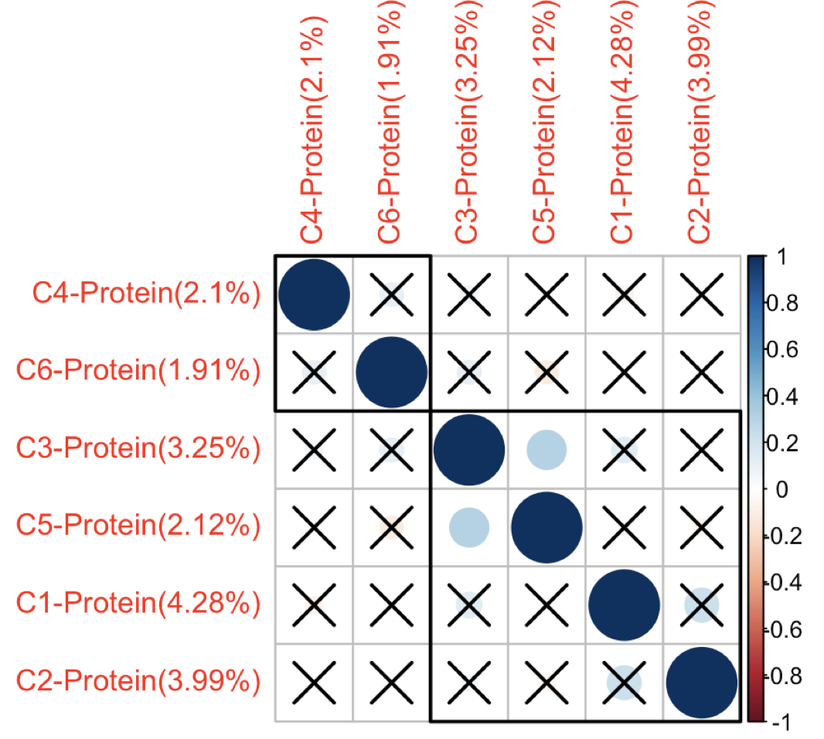
O2PLS – Pearson correlations
Notes:
And, this correlation diagrams clearly show why O2PLS is outperforming univariate correlation approach.
Add cross on no significant coefficient & hierarchial clustering and divide by boxes & correlation circles

Slide 32
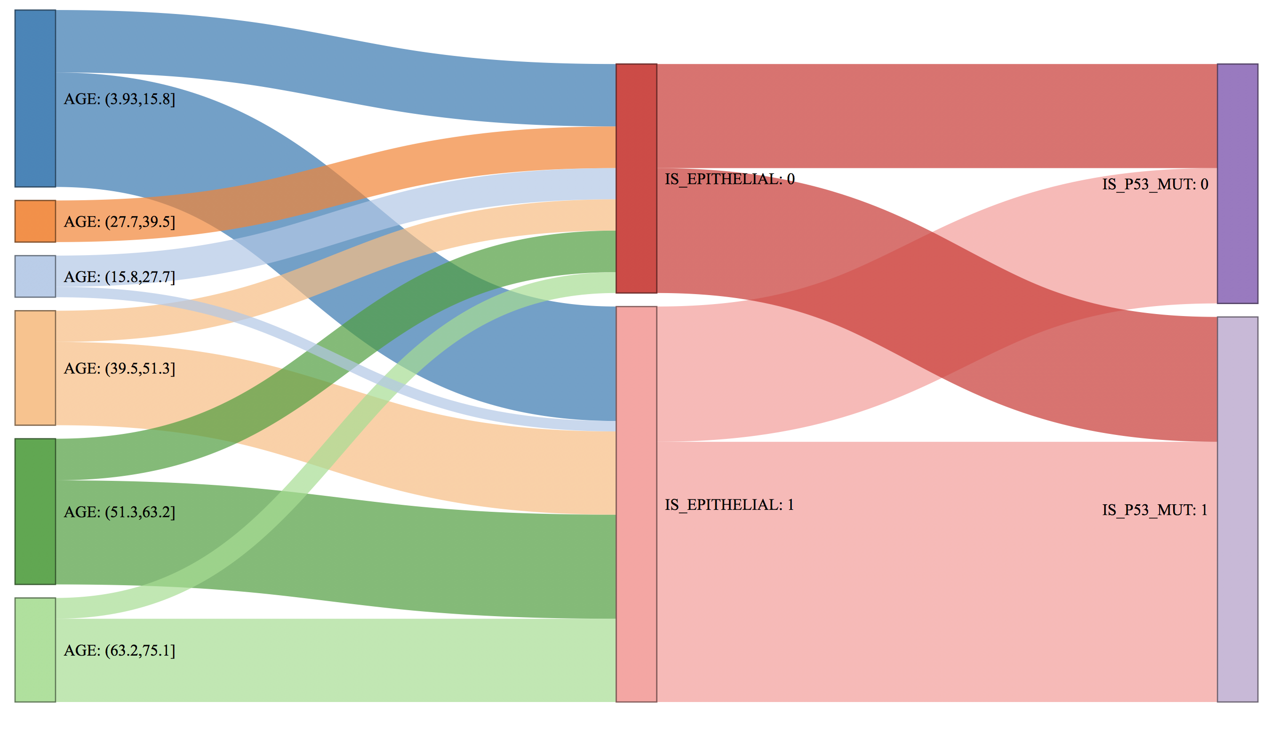
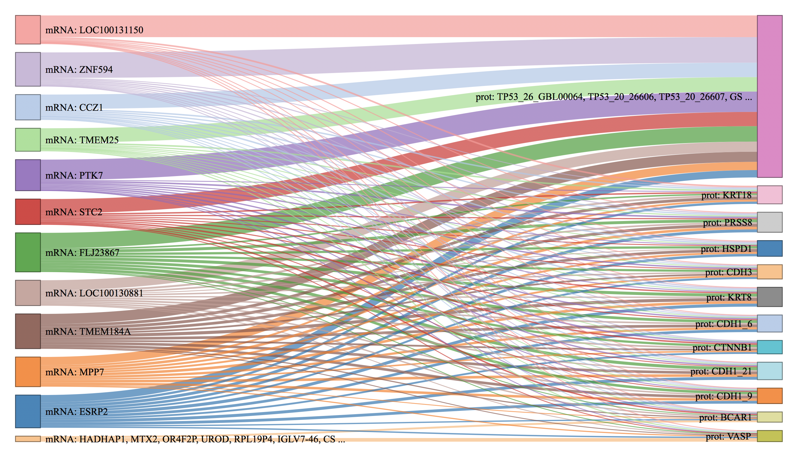
O2PLS – Sankey diagram
Notes:
*On the website, it will look way more cooler than this. you can simply move around the boxes vertically, so it would visually better and easier to see the names.
Left diagram: Samples age ~ Epithelial ~ mutation
Right diagram: Get the rowsums for joint loading matrices for both datasets, and get the top 50 mRNA and Proteins from these rowsums, and save the name of the variables, get linear correlations.

Slide 33
Demo
Demo
Notes:
Languages and Tools using: ajax, java, R, xhtml, css
Backend statistical computation is implemented with R.
Java server technology using Primefaces library.
AJAX allows web pages to be updated asynchronously by exchanging data with a web server behind the scenes. This means that it is possible to update parts of a web page, without reloading the whole page. (cited)
XHTML is based on XML, and thus requires the source to be well-formed. Since XHTML is more strict than HTML, less pre-processing is needed by the rendering engine. (cited)
https://www.w3schools.com/HTML/html_xhtml.asp
https://www.educba.com/html-vs-xhtml/

Slide 34


Thanks to
Prof. Jeff Xia
Othman Soufan
Peng Liu
Mai Yamamoto
Guangyan Zhou
Jasmine Chong
Orcun Hacariz
Janice Ou
Farial Karimian
Dana Praslickova

Slide 35
Bibliography
Sung J., et al. (2016). Metabolomic modeling with Big Data and the gut microbiome. Applied & Translational Genomics. (https://www.sciencedirect.com/science/article/pii/S2212066115300405)
Bouhaddani S.e., et al. (2016). Evaluation of O2PLS in Omics data integration. BMC Bioinformatics. (https://bmcbioinformatics.biomedcentral.com/articles/10.1186/s12859-015-0854-z)
Löfstedt T., et al. (2013). Global, local and unique decompositions in OnPLS for multiblock data analysis. (https://www.sciencedirect.com/science/article/pii/S0003267013008490)
Zhou, G. (2019). Network-based approach: towards multi-omics integration and systems-level understanding. (Seminar Presentation)

